Slide 1
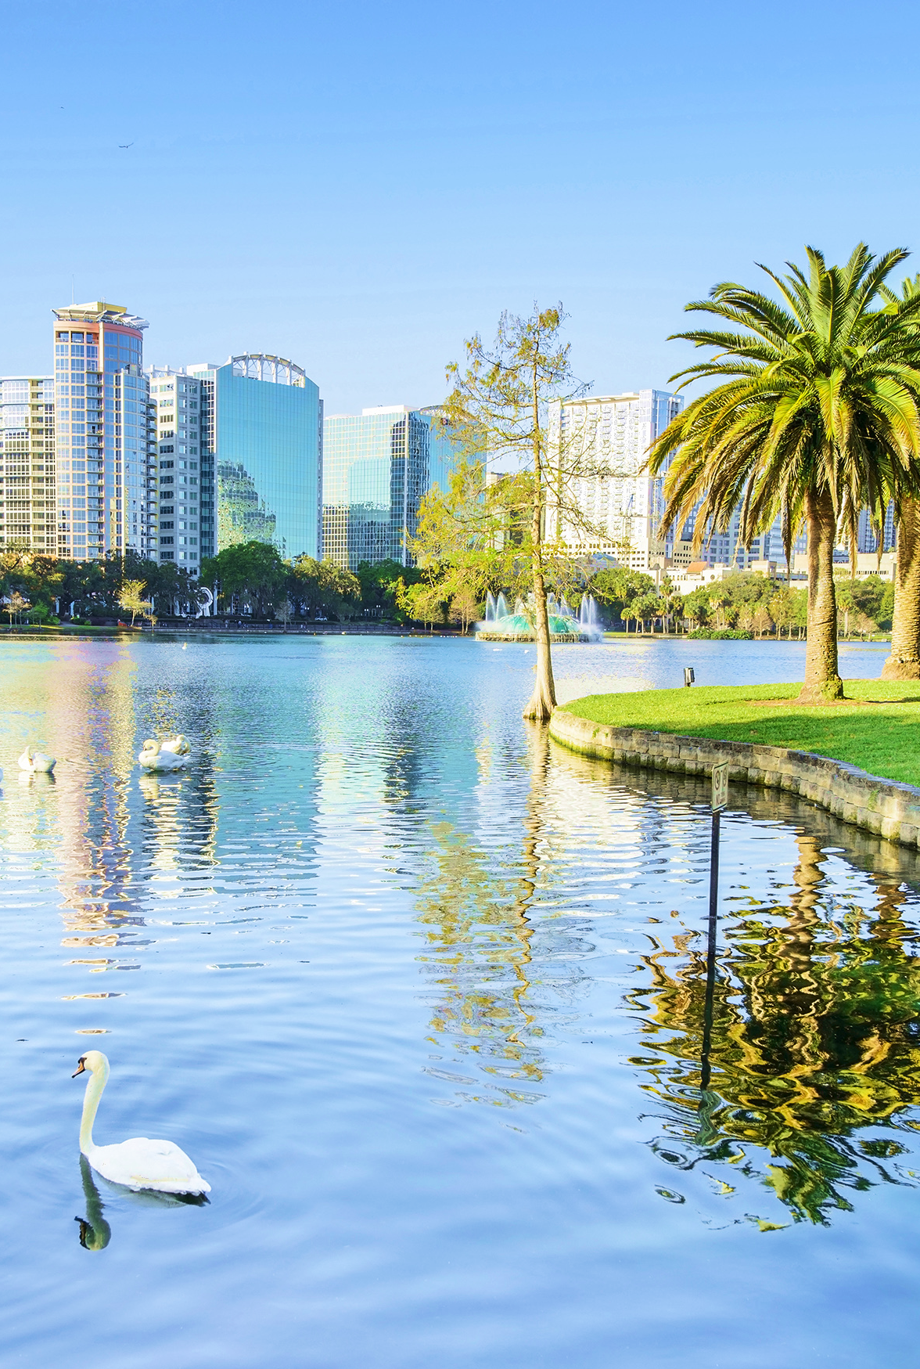

Slide 2
Exploring Volumes with GeoGebra Dissection Models
Dr. Thomas (Tom) Cooper
Professor, University of North Georgia
Department of Mathematics
Dahlonega Campus
tom.cooper@ung.edu
http://faculty.ung.edu/tecooper/

Slide 3
BIG IDEA
Software such as Geogebra allows us to build, view, and manipulate 3D objects.
We can explore volume formulas intuitively.

Slide 4
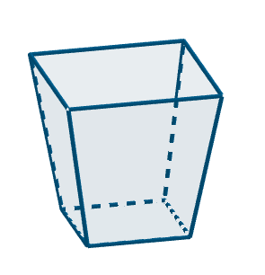
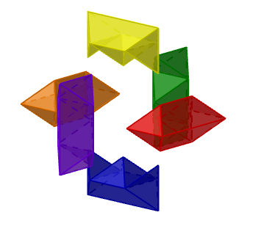
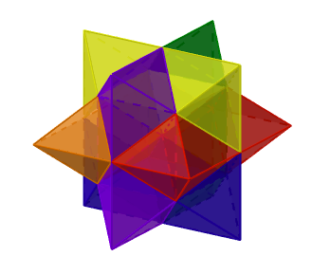
Two Interesting Solids
Frustum of a Square Pyramid
Burr Buzzle & Pieces

Slide 5

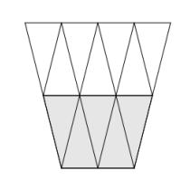
https://www.gathering4gardner.org/g4g13gift/math/BanchoffThomas-GiftExchange-Foxtrot-G4G13.pdf

Slide 6
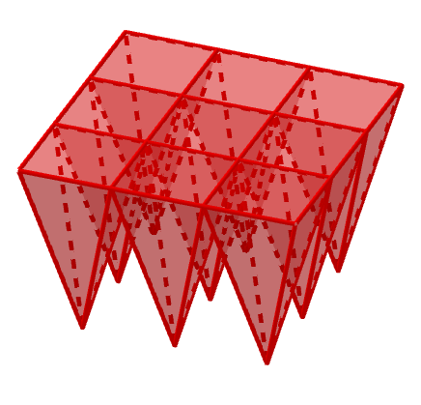
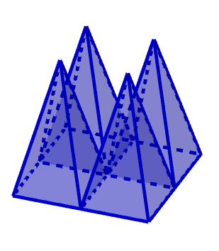
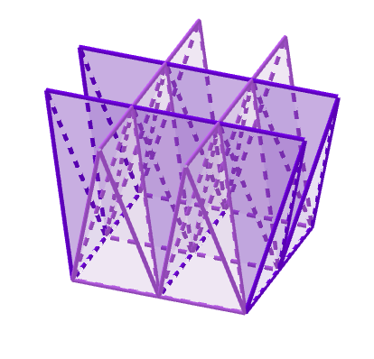
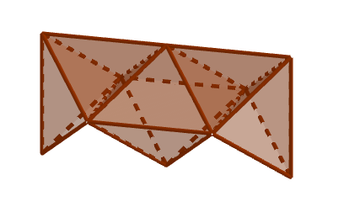
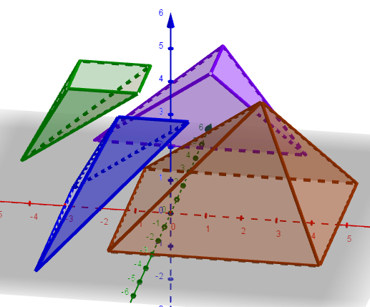
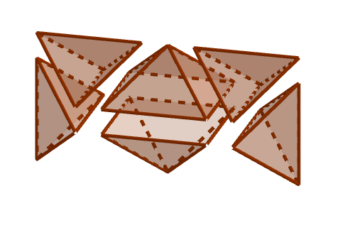
Both can be decomposed into square pyramids and “semi-orthocentric” tetrahedra.

Slide 7
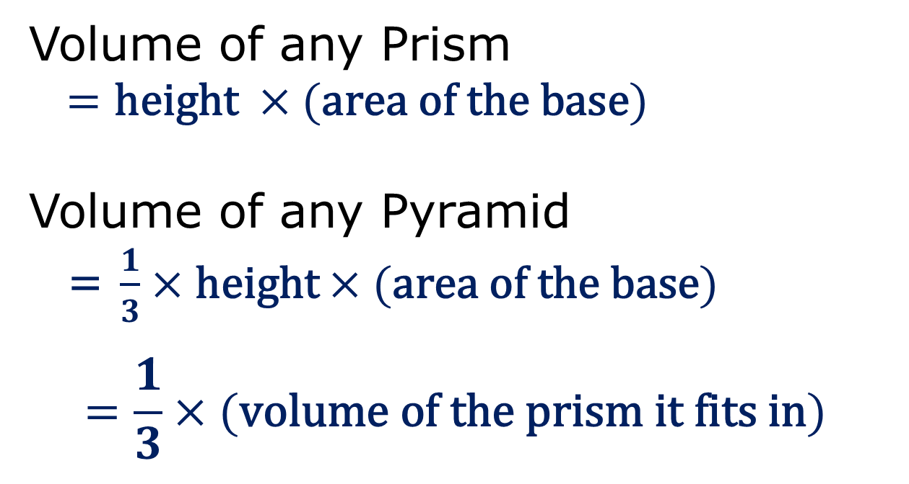
Some Volumes We Can Explore Intuitively
Volume of any Prism
$=\text{height} ×(\text{area} \text{of} \text{the} \text{base})$
Volume of any Pyramid
= $\frac{1}{3}×\text{height}×(\text{area} \text{of} \text{the} \text{base})$
$$=\frac{1}{3}×(\text{volume} \text{of} \text{the} \text{prism} \text{it} \text{fits} \text{in})$$

Slide 8
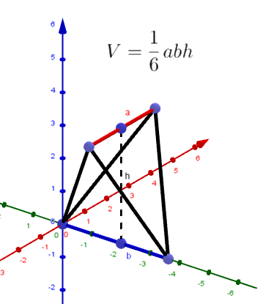
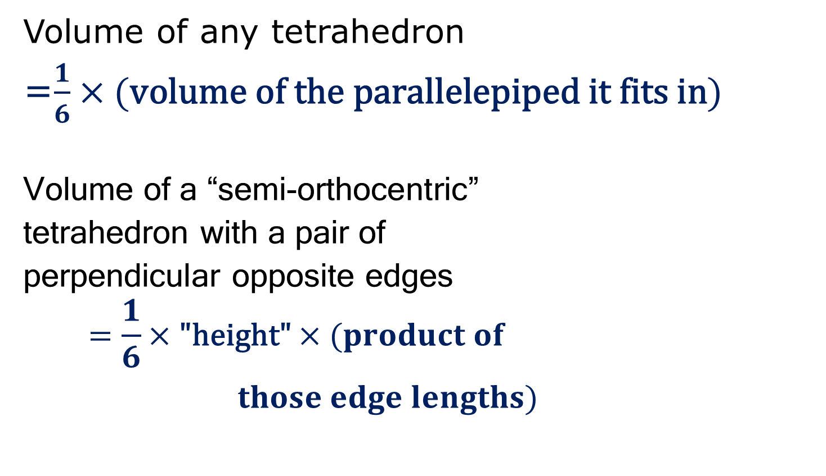
Some Volumes We Can Explore Intuitively
Volume of any tetrahedron
=$\frac{1}{6}×(\text{volume} \text{of} \text{the} \text{parallelepiped} \text{it} \text{fits} \text{in})$
Volume of a “semi-orthocentric”
tetrahedron with a pair of
perpendicular opposite edges
$$=\frac{1}{6}×\text{"}\text{height}\text{"}×(product of$$
$those edge lengths)$

Slide 9
Now to Geogebra …

Slide 10
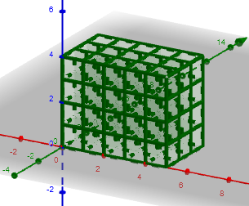
Prisms
The volume of a right rectangular prism is
LWH = height × (area of the base).
GeoGebra Model of Prisms

Slide 11
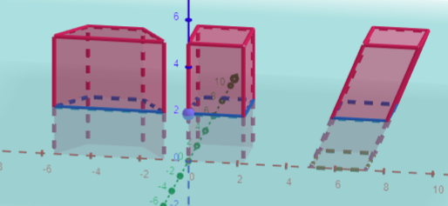
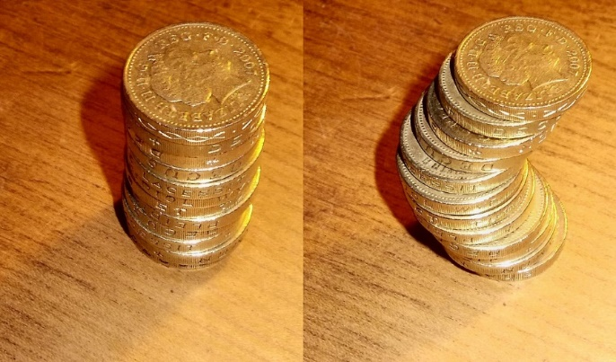
Prisms
By Cavalieri’s Principle, the volume of any prism is height × (area of the base).
Geogebra Model of Cavalieri for Prisms
GeoGebra Model of Cavalieri for Pyramids

Slide 12
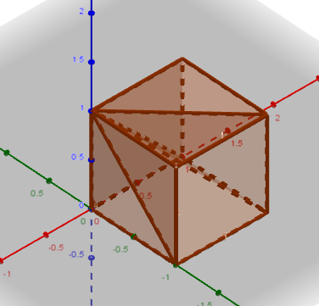
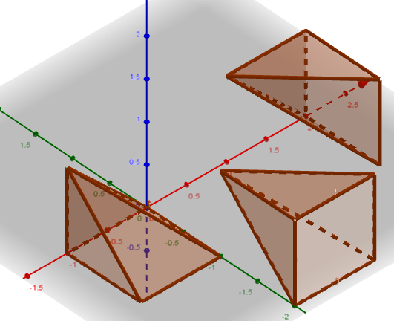
Pyramids (Volume = 1/3 Prism)
Geometric Argument by decomposition
Any pyramid (including cone) by Cavalieri’s Principle
These were
called “Yangma”
by Liu Hui in
The Nine Chapters
on the Mathematical Art ,
263 AD
GeoGebra Model
for a Cube
More General Case (GGB)
using a pyramid with a right triangle base

Slide 13
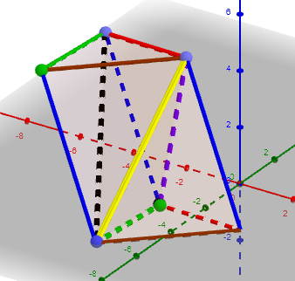
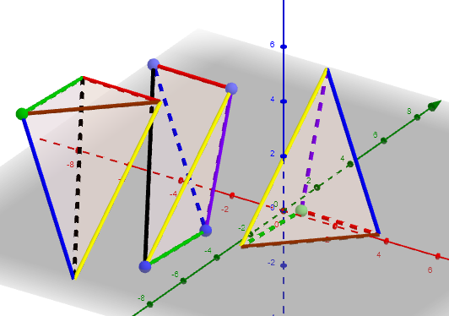

Tetrahedron
Volume=$\frac{1}{6}\left|a×b∙c\right|$
By decomposition, Volume of tetrahedron
= 1/3 x (Volume of Triangular Prism
= 1/6 × (Volume of Parallelepiped)
GeoGebra Construction

Slide 14
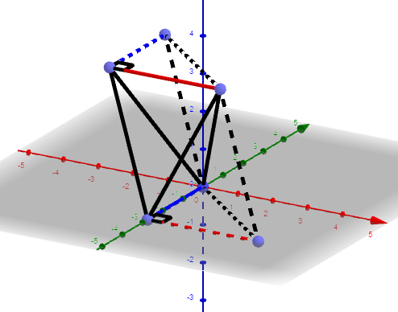

Semi-Orthocentric Tetrahedron
When a pair of opposite edges are “perpendicular”, Volume = 1/6 × h × product of these side lengths.
Volume=$\frac{1}{6}\left|a×b∙c\right|$
Geogebra Model

Slide 15
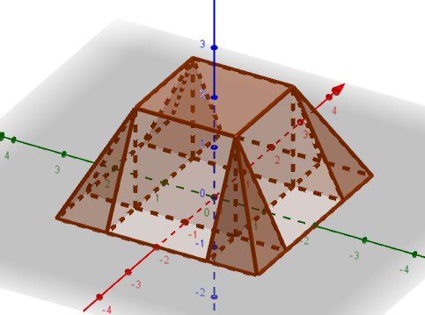
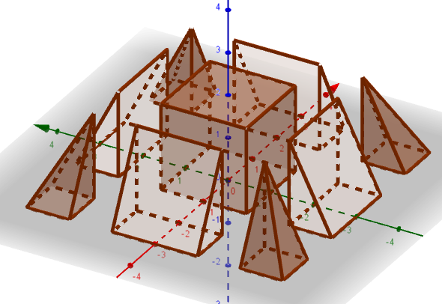
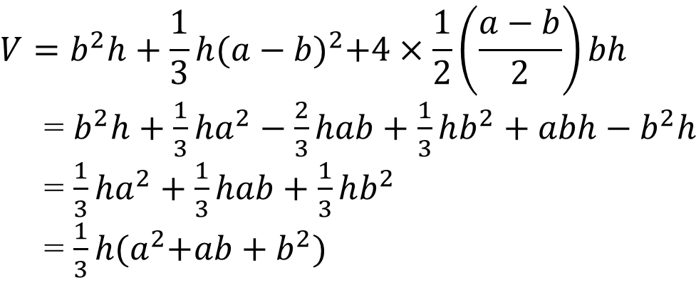

Frustums
(with Square Bases)
$$V=b^{2}h+\frac{1}{3}h{(a−b)}^{2}+4×\frac{1}{2}\left(\frac{a−b}{2}\right)bh$$
= $b^{2}h+\frac{1}{3}ha^{2}−\frac{2}{3}hab+\frac{1}{3}hb^{2}+abh−b^{2}h$
= $\frac{1}{3}ha^{2}+\frac{1}{3}hab+\frac{1}{3}hb^{2}$
= $\frac{1}{3}h{(a}^{2}+ab+b^{2})$
$$h$$
GeoGebra Model
Liu Hui’s (263 AD)decomposition into a square prism,
4 “qiandus” (triangular prisms), and 4 “yangmas” (square pyramids)

Slide 16
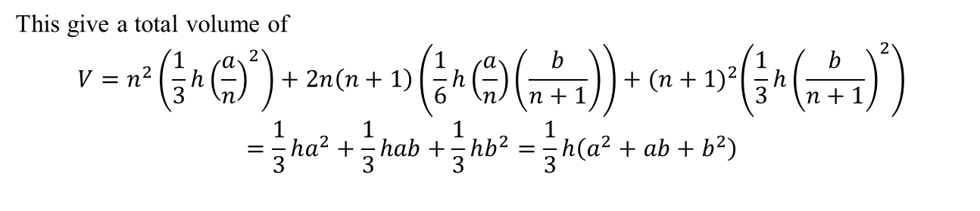

Dissection Idea of Tom Banchoff
(Professor Emeritus Brown University)
Divide the bottom into n by n squares, and divide
the top into (n+1) by (n+1) squares.
The frustum can be divided in:
n² pyramids pointing up, each with $V=\frac{1}{3}h{\left(\frac{a}{n}\right)}^{2}$
(n+1)² pyramids pointing down, each with $V=\frac{1}{3}h{\left(\frac{b}{n+1}\right)}^{2}$
2n(n+1) semi-orthocentric tetrahedra, with $V=\frac{1}{6}h\left(\frac{a}{n}\right)\left(\frac{b}{n+1}\right)$
This give a total volume of
$$V=n^{2}\left(\frac{1}{3}h{\left(\frac{a}{n}\right)}^{2}\right)+2n\left(n+1\right)\left(\frac{1}{6}h\left(\frac{a}{n}\right)\left(\frac{b}{n+1}\right)\right)+{(n+1)}^{2}\left(\frac{1}{3}h{\left(\frac{b}{n+1}\right)}^{2}\right)$$
$$=\frac{1}{3}ha^{2}+\frac{1}{3}hab+\frac{1}{3}hb^{2}=\frac{1}{3}h\left(a^{2}+ab+b^{2}\right)$$
GeoGebra Model

Slide 17
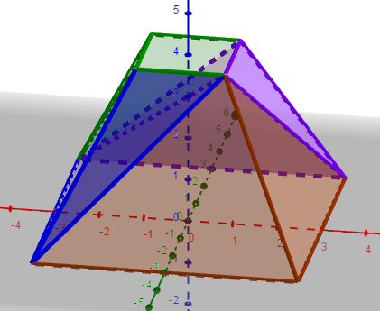
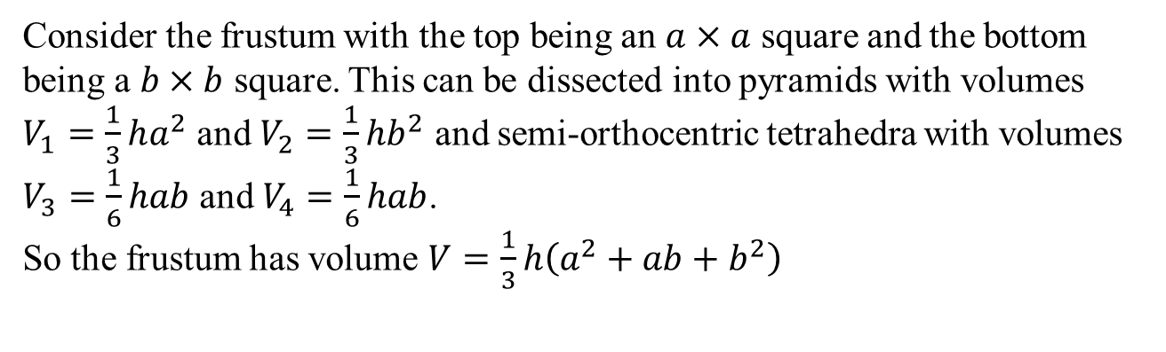
Four Piece Dissection
GeoGebra Model
Consider the frustum with the top being an $a×a$ square and the bottom being a $b×b$ square. This can be dissected into pyramids with volumes $V_{1}=\frac{1}{3}ha^{2}$ and $V_{2}=\frac{1}{3}hb^{2}$ and semi-orthocentric tetrahedra with volumes $V_{3}=\frac{1}{6}hab$ and $V_{4}=\frac{1}{6}hab$.
So the frustum has volume $V=\frac{1}{3}h\left(a^{2}+ab+b^{2}\right)$

Slide 18
Burr Puzzle
GeoGebra Model

Slide 19
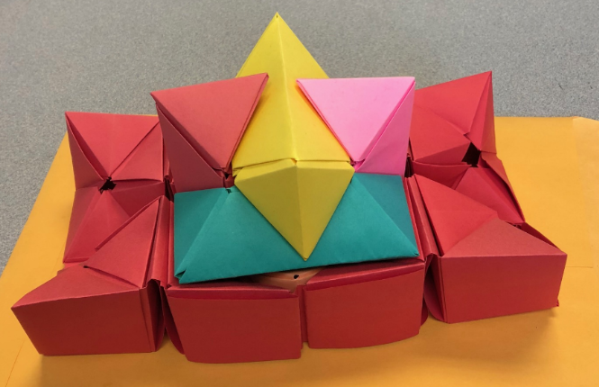
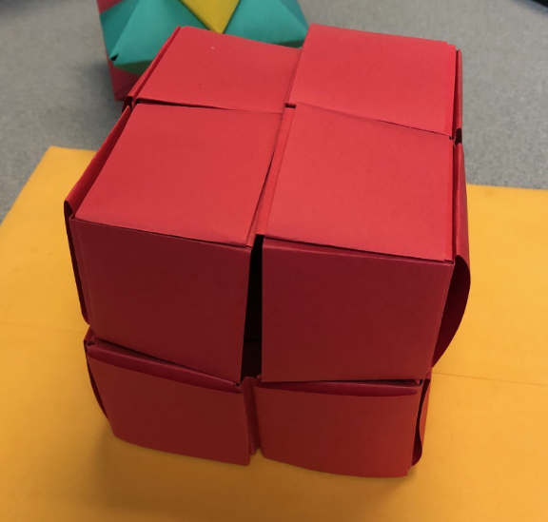
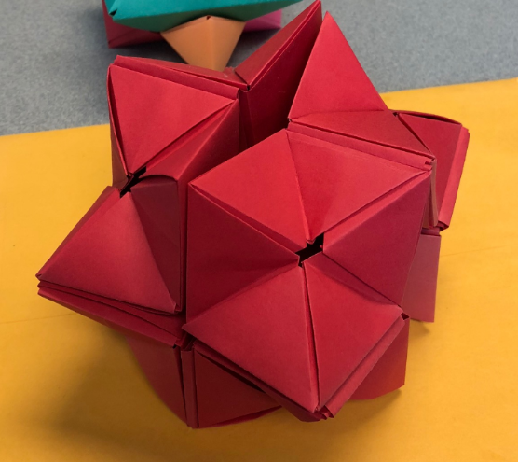
Yoshimoto Cube
GeoGebra Demonstration
Eureka!

Slide 20
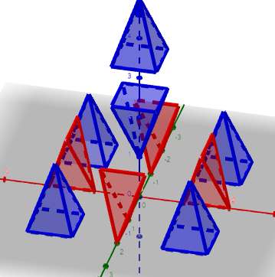
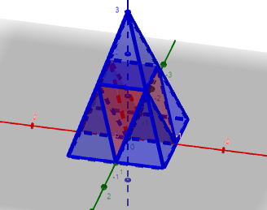
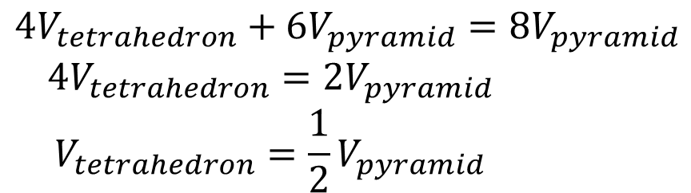
Bonus: Another “Proof” for Square Pyramids
$$4V_{tetrahedron}+6V_{pyramid}=8V_{pyramid}$$
$$4V_{tetrahedron}=2V_{pyramid}$$
$$V_{tetrahedron}=\frac{1}{2}V_{pyramid}$$
Pyramid Model

Slide 21
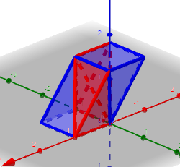
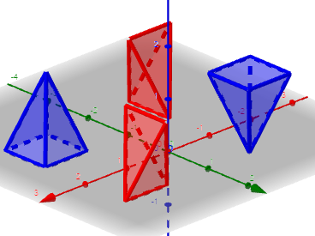
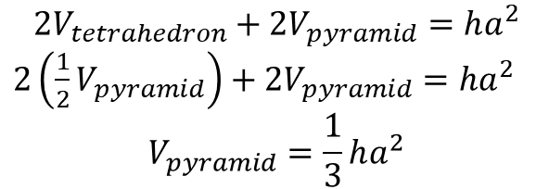
Prism Model
$$2V_{tetrahedron}+2V_{pyramid}=ha^{2}$$
$2\left(\frac{1}{2}V_{pyramid}\right)+2V_{pyramid}=ha^{2}$
$$V_{pyramid}=\frac{1}{3}ha^{2}$$

Slide 22
Mobile App Session Survey
Find the session by using the search field
Click on session and locate session survey
Complete quick survey
Your feedback is important to us…
THANK YOU!

