Slide 1
BUSA 3110
Statistics for Business
Spring 2015
Kim Melton
kmelton@ung.edu
132 Newton Oakes Center, Dahlonega Campus
706-867-2724

Slide 2
The Course
Uses data
From situations where variation exists
In quantitative models
To guide decisions
That inform action
Statistics
Applied
For use in a practical setting
Where theoretical assumptions may not apply perfectly
Results and limitations need to be communicated in the language of the situation

Slide 3

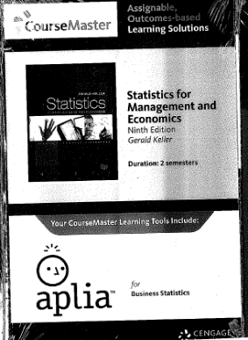
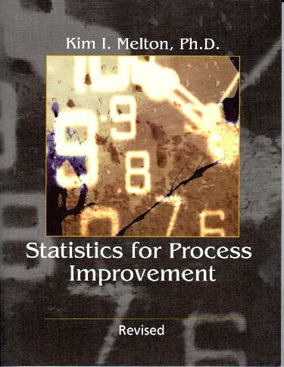


The Mechanics
Who are we?
  Students
  Professor
Support Materials
  Texts
  Software
  On-line
Expectations
  Syllabus
  Learning behaviors

Slide 4

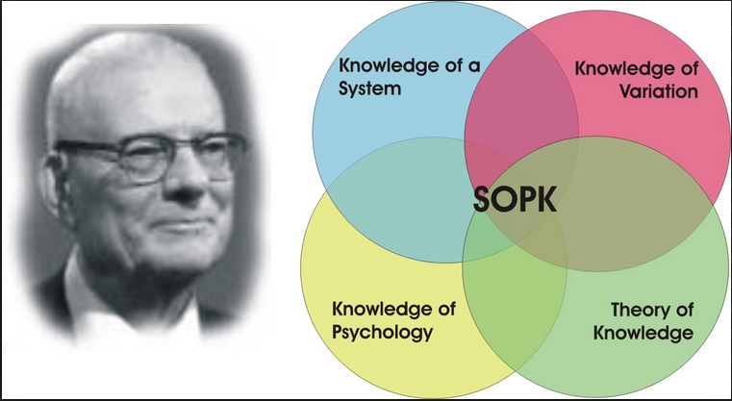

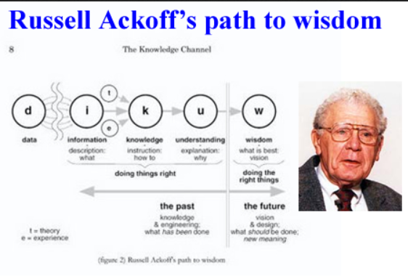

Instructor Background
System of
Profound Knowledge

Slide 5
Bad choice
Book Option Comparisons
Resource Material Covered | Bundle (purchased new) | Melton | Complete Keller 9 | Used Custom book
Keller Chapters 1-5, 11-12, 16-18 | YES | no | YES | YES
Keller Chapters 7-10, 13 | YES (online in Aplia) | no | YES | no
Aplia assignments (Choice assignments) | YES | no | no | no
Melton Process Improvement | no | YES | no | no

Slide 6
Assignment
Go to http://faculty.ung.edu/kmelton/BUSA3110.html
  Read the complete syllabus for the course
    Come to class next time with questions about the syllabus
  Go to the Assignment page and complete the assignment posted for January 7
    One reading assignment
    Watch three short videos (approximately 20 minutes total)
    Set up your Aplia but don’t enter a payment code until you are sure that you have your schedule finalized

Slide 7


Software for Calculations
Think “and” not “or”
Excel
  Pros
  Spreadsheet software that is widely available
  Familiarity
  Quick basic insight
  Cons
  Analysis ToolPak needed for statistical analysis beyond the most basic is not available on all platforms (e.g., Mac and Office 365)
  Analyses are not linked (especially graphical and inferential)
  Requires the user to have more statistical knowledge to use effectively and appropriately
  Limited in terms of analyses available
  Pros
    Available for Windows and Macs (born on the Mac)
    Statistical software with an interface that is similar to a spreadsheet
    Dynamically linked analysis
    Graphics first; computations follow
    Wide array of statistical analyses available in menu driven approach
  Cons
    Not as widely available
    Less familiar
    Requires new thought processes

Slide 8
Day 2
Syllabus questions
Analytics
Beyond Continual Improvement
Data, Information, Knowledge, Wisdom
Efficiency vs. effectiveness

Slide 9


Learning Expectations for Class
Attendance
  Arrive on time
  Stay the entire time
Preparation
  Spend time before class on homework
  Take notes while in class
Professionalism
  Take responsibility for learning
    Believe you can learn statistics
    Ask questions
    Try to answer questions
    Seek help EARLY when you are struggling
  Be ethical
  Put phones away
INVEST

Slide 10
The Changing Face of Statistics
Methods
  Calculations and Graphs
  Calculators and Tables
  Mainframe Computers and Specialized Software
  Personal Computers and Spreadsheets
  Personal Computers and Specialized Software
Users/Creators
  Limited individuals with specialized training/education
  Democratization of Statistics
Major Areas of Focus
  Descriptive
  Inferential
  Process oriented
  Big Data and Analytics

Slide 11
Business Statistics – Past…
Descriptive (a little time)
  Summary statistics
  Graphical insights
Inferential (lots of time)
  Populations and Parameters
  Samples and Statistics
  Hypotheses, confidence levels, and p values
  Generalizability from the sample to the population
Process Improvement (in between amount of time)
  Determining if past performance might be useful for predicting
  Understanding how changes in the process relate changes in characteristics of a product or service

Slide 12
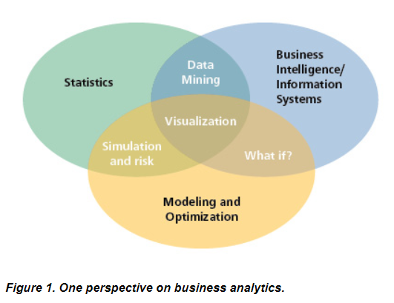
The Changing Face of Statistics
Business
Analytics
and
Big Data
Descriptive,
Predictive,
Prescriptive
http://www.decisionsciences.org/decisionline/
Vol43/43_2/dsi-dl43_2_feature.asp

Slide 13
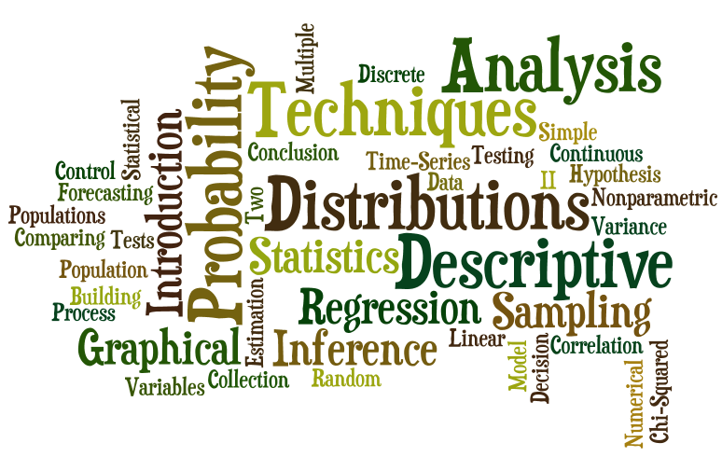
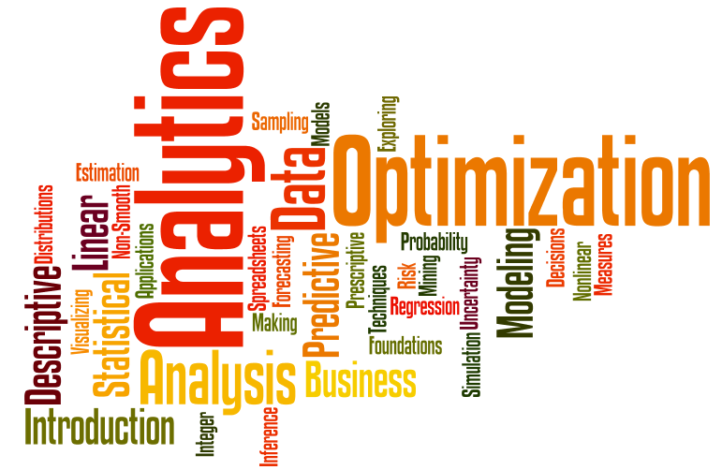
Word Clouds
(created at wordle.net)
Business Statistics Text ➔
⬅ Business Analytics Text

Slide 14








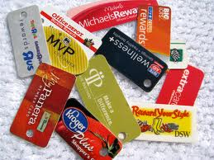



Slide 15
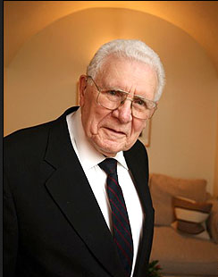
DIKW Continuum
Data
Information
Knowledge
Understanding
Wisdom
Dr. Russell Ackoff

Slide 16
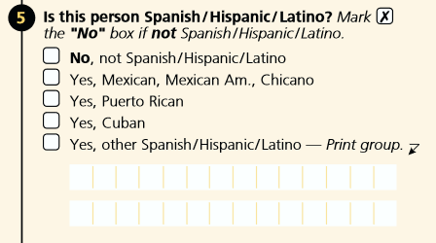
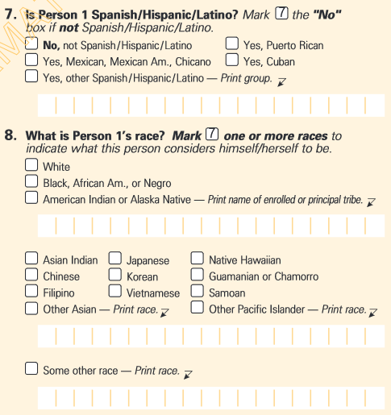
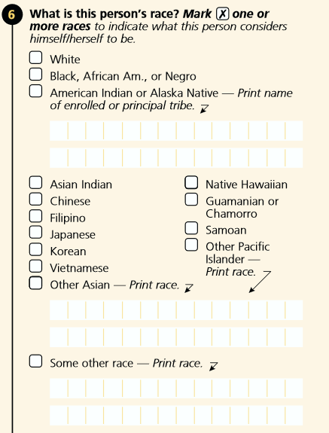
2000 Data –
From the Census
https://www.census.gov/history/pdf/2000_short_form.pdf
https://www.census.gov/history/pdf/2000_long_form.pdf
Both accessed August 9, 2014

Slide 17
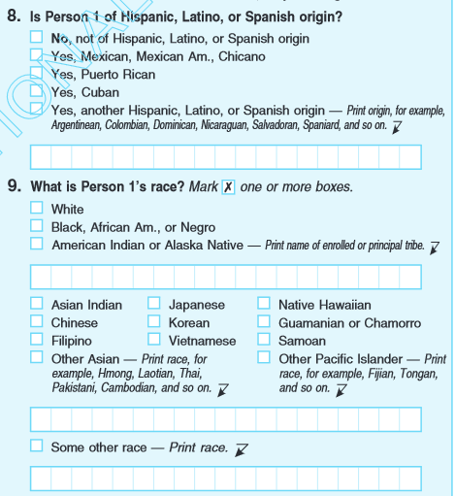
2010 Data –
From the Census
https://www.census.gov/history/pdf/2010questionnaire.pdf
Accessed August 9, 2014

Slide 18
Information
(Who, what, where, how many…)
Race | 2000 | 2010
White | ## | ##
Black, African Am., or Negro | ## | ##
American Indian or Alaska Native | ## | ##
Asian Indian | ## | ##
… | ## | ##
… | ## | ##
Assume the numbers are provided as a percent.
What would it mean if the percent reported as “White” went down between 2000 and 2010?

Slide 19
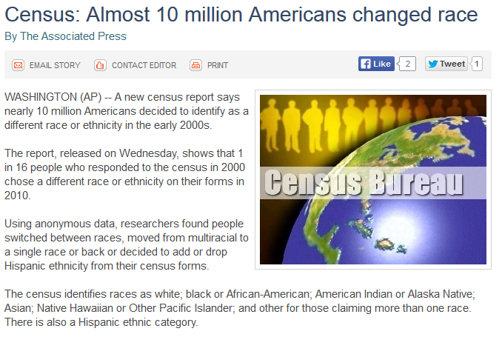
Information
http://www.accessnorthga.com/detail.php?n=277983
Accessed August 9, 2014

Slide 20

Knowledge/Understanding
(How to - Describes; Why - Explains)

Slide 21
Wisdom—requires “value” judgment; relates to effectiveness
(at a higher societal level)
Doing things right vs. doing the right things
(efficiency) (effectiveness)
  Can an organization/individual be efficient but not effective? (examples…)
  Can an organization/individual be effective but not efficient? (examples…)
  Which should be addressed first (efficiency or effectiveness)?

Slide 22
All models are correct – in some other world.
W. Edwards Deming
All models are wrong – but some are useful.
George Box
Any model is an approximation of the situation.
The closer the “match,” the more useful the model.

Slide 23
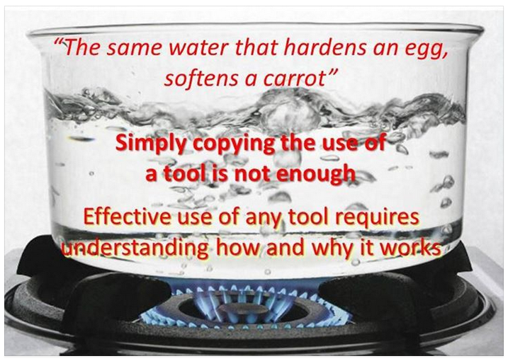
Models (and theories) must be viewed in a context

Slide 24
Henry Ford’s desire
To make a car that was affordable to the masses.
  Knowledge and understanding could help design and produce the car
  Wisdom helps address the implications
    Good
      …
    Bad or Not so good
      …

Slide 25
Homework
Posted at faculty.ung.edu/kmelton/busa3110.html
  Reading assignment in the Keller book (with material to bring to the next class)
  Aplia assignment available for Sunday night (Choice points)

