Slide 1
BUSA 3110 Statistics for Business Spring 2015 Data Segment
Kim Melton
kmelton@ung.edu
132 Newton Oakes Center, Dahlonega Campus
706-867-2724

Slide 2
Supporting Material
Keller book
Chapter 1: Overview of where we use data
Chapter 2, Section 1: Levels of measurement
Chapters 2 and 3: To recognize various types of graphs and the data needed to construct them [These chapters also tie to the Information Segment of the course]
Chapter 4: For distinction between using data to describe samples and populations [This chapter also ties to the Information Segment of the course.]
Other
Supporting material for using JMP

Slide 3

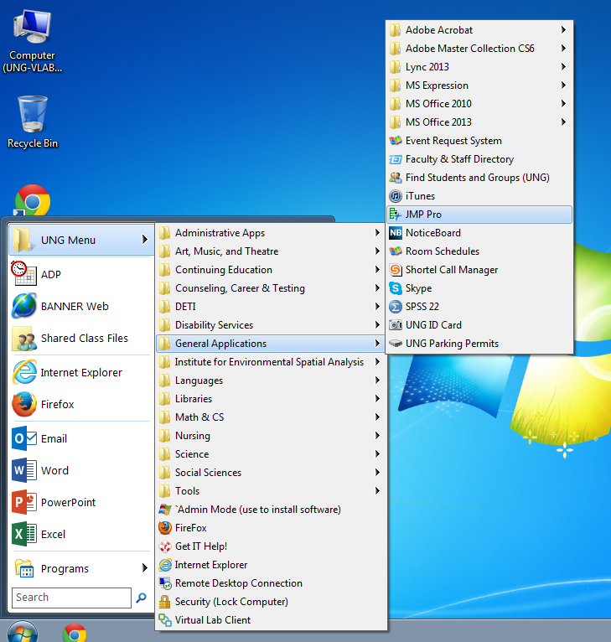
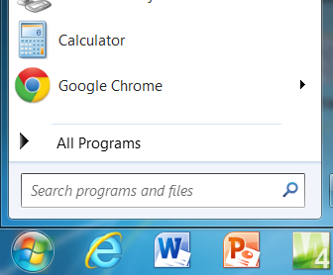
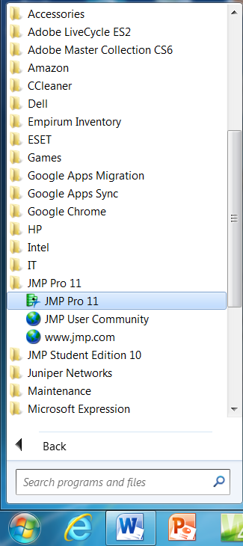
JMP Software (software.ung.edu)
Dahlonega Campus Computers
Virtual Lab
OR
If you get a message about downloading the software to that machine, do so by selecting the default options at each step.

Slide 4
The Historical Role of Data in Statistics
Describe (Descriptive Statistics)
Summarizes data
Graphically
Through formulas and tables
Infer (Inferential Statistics)
Use data from a small number of observations to draw conclusions about the larger group
Improve (Process Studies)
Use data from past experience to help predict expected outcomes at a different time or place or to direct action to influence future outcomes

Slide 5
The Evolving Role of Data in Statistics
Descriptive/Informative
Includes current descriptive and inferential statistics
Looks at past and current performance to “describe”
Predictive/Explanatory
Looks at past and current performance with a goal of predicting future performance (i.e., to be able to “explain”)
Addresses “what if” questions
Prescriptive/Understanding of Interactions & Implications
Uses quantitative models to assess how to operate in order to achieve some objective within constraints (and may include deterministic and probabilistic aspects)

Slide 6
Underlying Concepts/Terms (Chapter 1)
Variables
Data
Operational definitions
Extending conclusions beyond the current dataset
Theories and Hypotheses
Using statistics from a sample
To draw some conclusion about the corresponding parameter of a population
Noticeably missing—statistics for use in analyzing processes

Slide 7
Data – What, Why, and How
What question are we trying to answer?
Why would we want to collect data? What are we trying to accomplish?
Describe
Understand and Explain
Predict or Prescribe
How should we collect data that will allow us to use the data to help direct action?

Slide 8
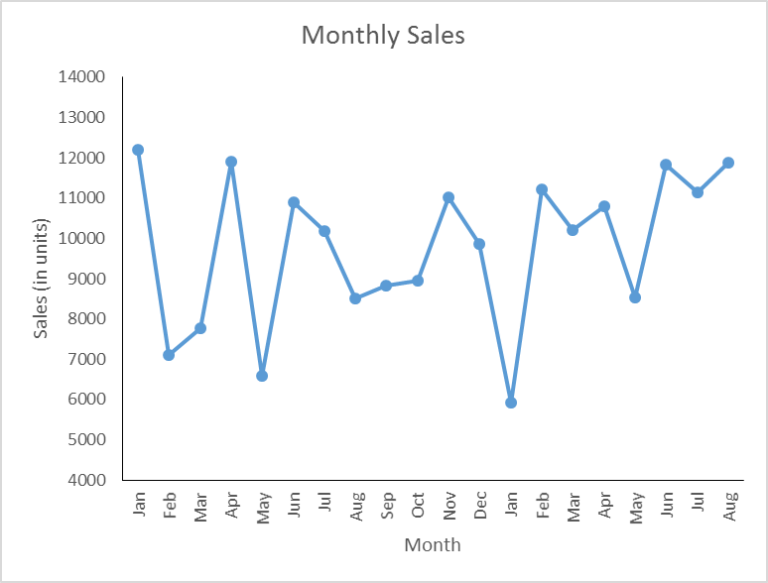
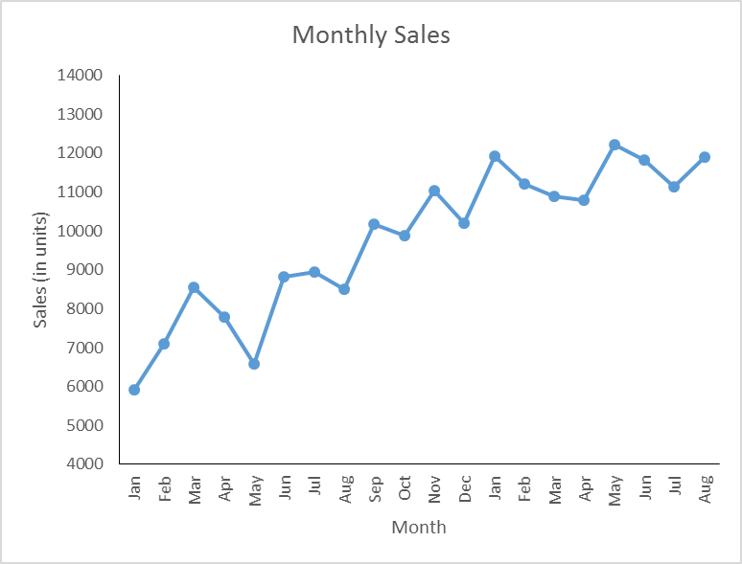
Describe, Explain, Understand, Predict, Prescribe
What were our sales for the month? (describing)
How does this compare to the same month last year? (still describing)
What’s changed that might account for the differences? (moves toward explaining)
Why have sales changed? (starts to move from explaining to understanding)
What will sales be in the future? (predicting and/or prescribing)

Slide 9
Levels of Measurement (Chapter 2)
Nominal – Qualitative; categorical; order has no meaning
Ordinal – Qualitative; categorical; order has meaning; distance between categories does not
Interval – Quantitative; distance has meaning; zero is “arbitrary”
Ratio – Quantitative; distance has meaning; zero equates to “none of”
Often “lumped together”— your book calls both “interval”; JMP calls both continuous
{

Slide 10
Selecting the appropriate level
Major
Grade in a course
Job title
Year in school (Freshman,…, Senior)
Price of a gallon of regular gas
Salary
Time to complete a task
Rank of your favorite college team
Uniform numbers on football jerseys
Size of a house
Gender
Level of agreement (1, 2, …, 9, 10 where higher numbers relate to stronger agreement)

Slide 11
Calculations and Levels of Measurement
For the results of addition, subtraction, multiplication, and division to have meaning, data needs to be at least interval in scale.
For the results of calculations to be useful in prediction/estimation, certain conditions must exist in terms of how the data are collected.

Slide 12
Descriptive Statistics
Summary measures for some situation
May be meant to provide general information about that situation
May be intended (under appropriate conditions) to be used to generalize to some larger group.
Increasingly (and with major assumptions), used to say something about what to expect in some other time or place.

Slide 13
Inferential Statistics (in layman’s terms)
You have:
Large group of interest
A small number of “representative” observations from that group
You want:
To draw some conclusion about a characteristic of the large group based on what you observe from the observations available
You know:
That your conclusion could be wrong, but you want to be “close.”

Slide 14
Statistic vs. Parameter
Parameter
Summary characteristic of a population (a single, but unknown value)
Usually written with a Greek letter
Statistic
Summary characteristic for a sample
Can vary from sample to sample from the same population
μ , σ , β
x , s , b

Slide 15
Populations and Parameters Samples and Statistics
Population
The collection of all items of interest OR more specifically:
The measurements that would be obtained from evaluating all items of interest
Parameter
A summary measure obtained by using data from all elements of the population
Usually identified with a Greek letter (μ, σ, π, β₀)
Sample
A subset of the population (the items actually examined) OR more specifically:
The measurements that are obtained from the subset of the population
Statistic
A summary measure obtained by using the data obtained from the sample
Usually identified with traditional English letters ( , s, p, b₀)

Slide 16
Statistical Inference – Textbook Fashion
There is a population with a parameter of interest
Probability sampling is used to identify elements to include in a sample
Data are obtained from the elements in the sample
A statistic is calculated to estimate the parameter
Results are communicated with a level of confidence and/or a margin of error

Slide 17
Statistics for Process Studies (we’ll come back to this later)
Two issues arise:
Changes can occur in an on-going process while you are collecting data—i.e., you don’t know if all of your data is coming from the same population
Although describing past output may be useful, this is descriptive (history). You really want to be able to know what to expect in the future—i.e., you aren’t trying to make an inference about the process as it existed while you were collecting data.

Slide 18
Data
There is no such thing as “objective data.” Someone decides:
What data to collect
When to collect the data
How to collect the data
How to define the characteristic of interest
Some data are more objective than other data.
Examples:
Write a one page paper describing _____.
Count the pages
What constitutes “most” of the time?

Slide 19
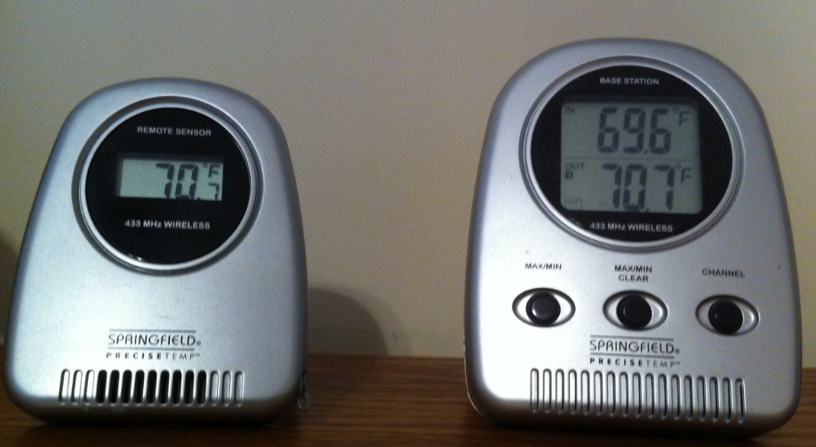
Characteristics of “Good” Data
Accuracy of measurement
Precision of measurement
Uses an appropriate type data (level of measurement)
Nominal, Ordinal, Interval, Ratio
Aligns with the characteristic of interest
Which data is easier to collect
Data on “learning”
Data on class sizes
Different numbers reflect differences in the items measured
Measurement is a yardstick for “how we are doing” rather than the “mission”
Parking Space Reserved for Drive-Thru

Slide 20
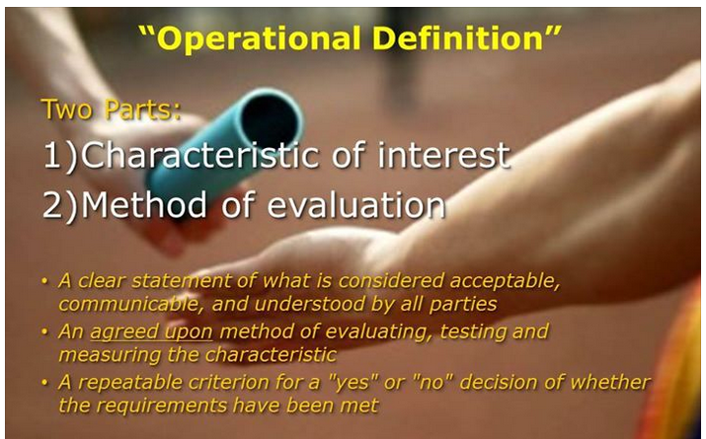
Operational Definitions
Tells: what to measure, how to measure, when to measure, and how to interpret the result
Suppose you were told to determine the number of windows in the building.

Slide 21


What vehicle is the “most stolen?”
If you were asked to compile a list of “most stolen” vehicles, how would you go about ranking vehicles?
What is a “vehicle?”
When is a vehicle considered stolen?
What level of detail and period of time will you use?
Are rankings based on raw counts or on relative counts?

Slide 22
Ford F-250 crew 4WD
Chevrolet Silverado 1500 crew
Chevrolet Avalanche 1500
GMC Sierra 1500 crew
Ford F-350 crew 4WD
Cadillac Escalade 4WD
Chevrolet Suburban 1500
GMC Sierra 1500 extended cab
GMC Yukon
Chevrolet Tahoe
Toyota Camry/Solara
Toyota Corolla
Chevrolet Impala
Dodge Charger
Chevrolet Malibu
Ford Fusion
Nissan Altima
Ford Focus
Chevrolet Cobalt
Honda Civic
1
3
1994 Honda Accord
1998 Honda Civic
2006 Ford Full Size Pickup
1991 Toyota Camry
2000 Dodge Caravan
1994 Acura Integra
1999 Chevrolet Full Size Pickup
2004 Dodge Full Size Pickup
2002 Ford Explorer
1994 Nissan Sentra
Dodge Charger
Pontiac G6
Chevrolet Impala
CHRYSLER 300
Infiniti FX35
Mitsubishi Galant
Chrysler Sebring
Lexus SC
Dodge Avenger
Kia Rio
2
4

Slide 23
Most Stolen Cars
Highway Loss Data Institute - Vehicles with the highest theft claim rates (2012)
Based on reported claims from insurance (and do not distinguish between contents and vehicle thefts)
http://www.bizjournals.com/nashville/morning_call/2013/07/car-thieves-top-10-favorites-least.html
National Insurance Crime Bureau – Most stolen vehicles (2011)
Based on vehicle thefts reported to law enforcement
https://www.nicb.org/newsroom/nicb_campaigns/hot%E2%80%93wheels
National Highway Traffic Safety Administration – Most stolen vehicles (2010)
Based on FBI data on reported vehicle thefts
http://www.nhtsa.gov/apps/jsp/theft/index.htm
National Highway Traffic Safety Administration – Most stolen vehicles (2010)
Based on FBI data on reported vehicle thefts per 1000 produced

Slide 24
Statistical Thinking Defined
A philosophy of learning and action based on the following fundamental principles
All work occurs in a system of interconnected processes
Variation exists in all processes
Understanding and reducing variation are keys to success American Society for Quality Glossary of Statistical Terms (1996)

Slide 25
Components of Statistical Thinking
All work occurs in a system of interconnected processes
Changes in one process often impact other processes
Optimization of individual processes does not guarantee optimization of the entire system
Variation exists in all processes
Some variation is “built in”—a function of how the process is designed
Some variation is special—sporadic in nature
Understanding and reducing variation are keys to success
Example: Consider the task of forming groups/teams
What needs to be similar across members of the group/team?
What variation needs to be included in the group/team?

Slide 26
Statistical Thinking Applied to Data Collection
Many important aspects of the work environment cannot be measured…but they can be managed.
Understanding concepts of statistical thinking can help us make decisions that are good for the organization.
Data collection (and measurement) is just one component of a larger process.
The purpose of collecting data will influence how data should be collected; or the data available will influence what conclusions can be drawn from the data.

Slide 27
Collecting Data
Purpose
Statistical Thinking
Is your goal:
To describe a well defined group
Where you can’t obtain data on every item in the group (population)
Where you will only be able to obtain data on part of the items in the group (using a sample to infer to the population)
To understand a process well enough to say something about potential future performance?
Addressing process stability and improvement
Identifying the items you would like to be able to describe
Determining the variables of interest
Operational definitions
Sampling plans
Identifying issues that can arise in data collection
Recognizing sources of variation
Due to sampling
In addition to sampling

Slide 28
Using Existing Data
Purpose
Statistical Thinking
Is your goal:
To describe that data set
To gain insight into the larger group that is represented by that data set
To make decisions about actions that will apply to other times/places
Selecting the appropriate data set for the question to be answered
Understanding the data collection process
Where (physical location and item specific)
When (date, point in a production process, ...)
How (method of sampling, contact, measurement, …)
by whom
Knowing the operational definitions
Assessing bias and error that could be inherent in the methods used to obtain the data

Slide 29
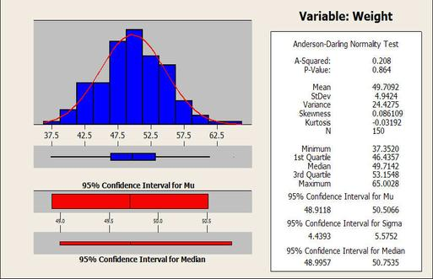
Moving from Data to Information
Graphical Approaches
Numerical Summary Measures
For the data at hand (a sample)
To say something about the population
Estimate a parameter
Test a hypothesis
NOTE: We will return to the Data Segment to address the collection of data for inference after we look at the following topics:
Graphical summary of data
Numerical summary of data

