Slide 1
Fall 2017: BUSA 3110 –
Statistics for Business
Week 1 – Day 1
Kim I. Melton, Ph.D.

Slide 2
Day 1: Overview
Location
Structure
Virtually:
  Information for the first few days at:
  faculty.ung.edu/kmelton/busa3110.html
  D2L for Statistics for Business Section DA Fall 2017
Physically: Class meets
  in the traditional classroom on Mondays and Fridays;
  in the lab (NOC 109) on Wednesdays
Who:
  Roll (and new university policies)
    Roll verification
    Repeats
What:
  Resources: Text, software, electronic resources
  Expectations
  Course Content

Slide 3
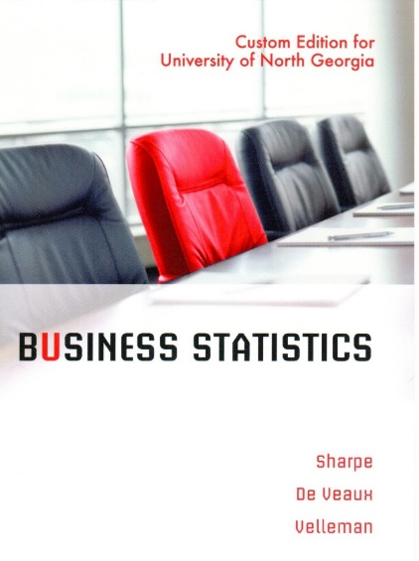
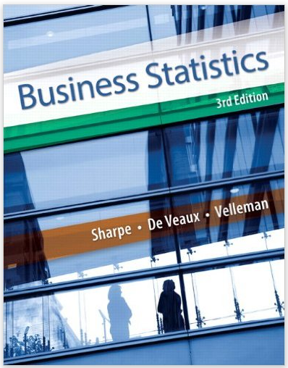
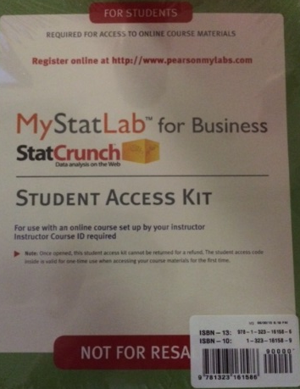


Purchased Resources
$$
Custom packet (available at the Bookstore)
  Includes:
    Selected chapters from Business Statistics, 3rd Edition by Sharpe, De Veaux, and Velleman
    Access to MyStatLab with
      MyStatLab homework assignments
      Complete text of Business Statistics, 3rd edition
      Answers to odd problems
      Data for problems in the text
      And more

Slide 4





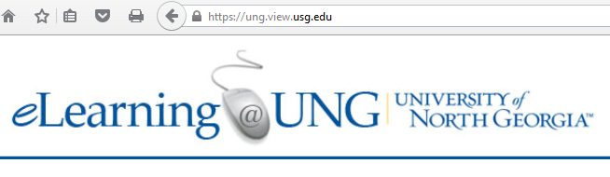






Other Resources (no extra costs)
(Links are available on the next slide)
D2L

Slide 5
Links (copy & paste):
  Open website for the first few days:
  http://faculty.ung.edu/kmelton/BUSA3110.html
  D2L login (remember that we will use Statistics for Business Section DA Fall 2017)
  https://ung.view.usg.edu/d2l/home
  JMP Software download (and instructions):
  Software.ung.edu
  UNG Virtual Lab:
  https://my.ung.edu/departments/information-technology/Pages/Remote-Access.aspx
  Microsoft Office download (right side of the page):
  https://my.ung.edu/departments/information-technology/Pages/Office-365.aspx
  MyStatLab logon page:
  mystatlab.com
Prep 1 calls for you to
access this site
Prep 3 relates to accessing correctly installed JMP software
MyStatLab assignment 1 is already available at this site.

Slide 6

Expectations
Be here
  Physically
    Put phones away and engaging in class
    Take notes
  Mentally
    Believe you can learn statistics
    Focus on the when, how, and why for the tools and techniques
    (not just on “getting the answer”)
On time
Prepared
  Read (for concept), read (for content), read (for understanding)
  Attempt practice problems
  Seek help EARLY when you are struggling
Engaged
  Take responsibility for learning
    Ask questions
    Try to answer questions

Slide 7
Course Content — Statistics!
Statistics
Uses data
From situations where variation exists
In quantitative models
To guide decisions
That inform action
Applied
For use in a practical setting
Where theoretical assumptions may not apply perfectly
And results and limitations need to be communicated in the language of the situation

Slide 8
Course Description
A second course in statistical methods with special orientation to applications in business. Emphasis will be placed on application of statistical techniques, assessing their appropriateness, and communicating results to various audiences. Topics include:
data collection,
sampling,
data visualization,
data analysis,
model building using regression, and
other statistical techniques.
Statistical software is used extensively in the course. This course should be taken as soon as the prerequisite is satisfied. Prerec: Admission to Upper Division and MATH 2400 with a grade of C or higher.

Slide 9
Learning Outcomes
(Course Level)
Upon completion of this course, students should be able to:
select appropriate statistical methods to guide decision-making
generate and use statistical output to analyze data
identify the limitations of the statistical methods covered
communicate how statistical studies were conducted and the results of those studies
recognize ethical issues related to the collection and analysis of data and the communication of the results of the analysis

Slide 10
Assignment for Completion (prior to next class)
(links: D2L and http://faculty.ung.edu/kmelton/busa3110.html)
Read the syllabus and complete Preparation Assignment 1 (Prep 1). This assignment is to be submitted to the D2L Assignment folder for Section DA by 5:00pm on Tuesday, August 22.
Read the Russell Ackoff 2 page document describing the Data/Information/Knowledge/Understanding/Wisdom continuum.
Read Chapter 24 from your text [omitting Section 7] (for concepts and refresher on some of the statistical techniques from your first course in Statistics). The entire text is available through MyStatLab; and this chapter is also included in the custom text at the bookstore.
Set up your MyStatLab account. You can work with temporary access for the first week.
MyStatLab Assignment 1 is available until 11:30 pm on Monday, August 28.
MyStatLab Assignment 2 will be available Tuesday, August 22 until 11:30pm on Tuesday, August 29.

