Slide 1
Fall 2016
BUSA 3110 - Statistics for Business
Week 1
Kim I. Melton, Ph.D.

Slide 2
Logistics
Roll
  Information for the first two weeks posted at: faculty.ung.edu/kmelton/busa3110.html
  Syllabus (Brief and Full online)
  Homework
  Slides for Week 1 and Module 1
During the second week, all of my sections will be combined in D2L under Section 1.

Slide 3
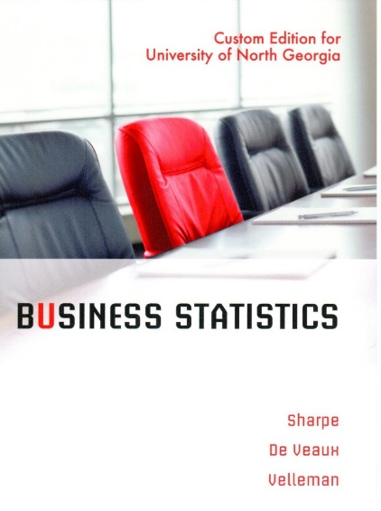
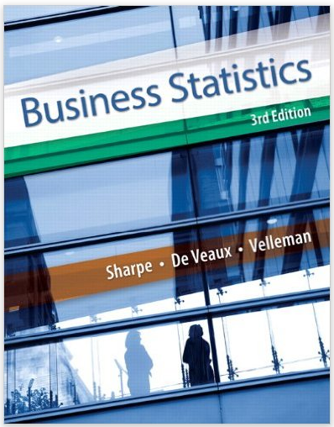
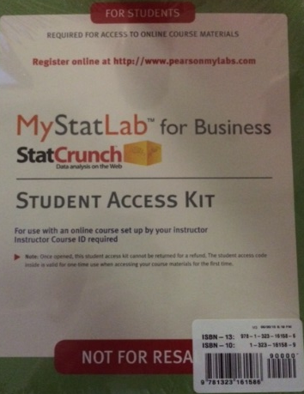


Materials That You Need to Purchase
Custom packet
(available at Dahlonega and Gainesville Bookstores)
  Includes:
    Selected chapters from Business Statistics, 3rd Edition by Sharpe, De Veaux, and Velleman
    Access to MyStatLab with
      Homework management system
      Chapter quizzes
      Complete text of Business Statistics, 3rd edition
      Answers to odd problems
      Data for problems in the text
      Videos
      And more

Slide 4
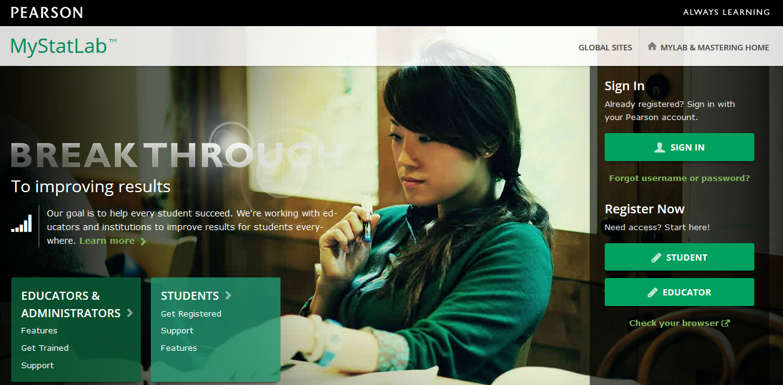
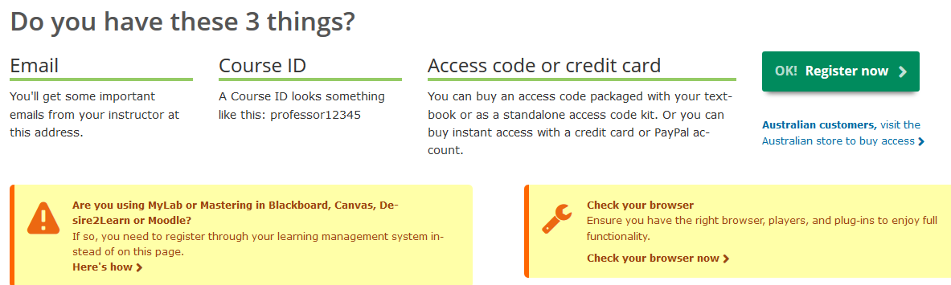
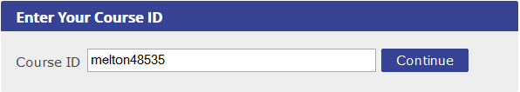
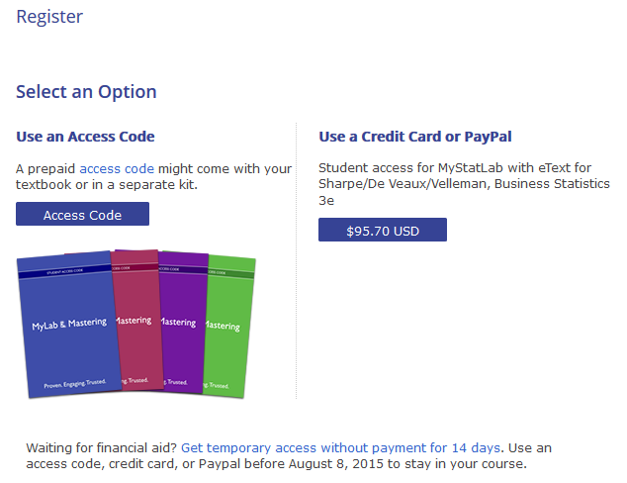
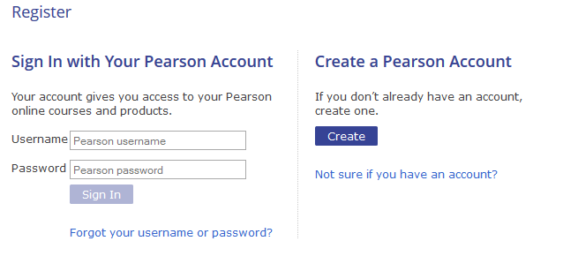
Setting up MyStatLab.com
Returning MyLab user
Ignore (for now): You will be able to use temporary access until Drop/Add ends.
Start here
New to MyLab products
Ignore - I will not be linking MyStatLab to D2L this semester.
melton17466

Slide 5


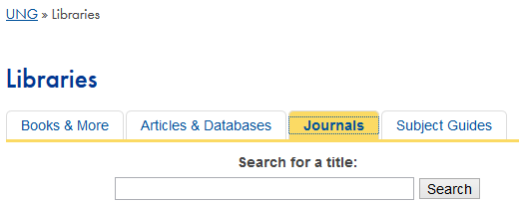



Other Support Materials
UNG Library
All of my sections will be combined into Section 1 after Drop/Add
D2L
Software.ung.edu

Slide 6


Learning Expectations for Class
Attendance
  Arrive on time
  Stay the entire time
Preparation
  Spend time before class reading
  (text and homework)
  Take notes while in class
  Work homework after class
Professionalism
  Take responsibility for learning
    Believe you can learn statistics
    Ask questions
    Try to answer questions
    Seek help EARLY when you are struggling
  Be ethical
  Put phones away
INVEST

Slide 7
Course Description
A second course in statistical methods with special orientation to applications in business. Emphasis will be placed on application of statistical techniques, assessing their appropriateness, and communicating results to various audiences. Topics include:
data collection,
sampling,
data visualization,
data analysis,
model building using regression, and
other statistical techniques.
Statistical software is used extensively in the course. This course should be taken as soon as the prerequisite is satisfied. Prerec: MATH 2400 with a grade of C or higher.

Slide 8
Learning Outcomes
(Course Level)
Upon completion of this course, students should be able to:
select appropriate statistical methods to guide decision-making
generate and use statistical output to analyze data
identify the limitations of the statistical methods covered
communicate how statistical studies were conducted and the results of those studies
recognize ethical issues related to the collection and analysis of data and the communication of the results of the analysis

Slide 9
What is/are Statistics?
Statistics vs. statistics
Statistics vs. Math

Slide 10
The Course
Statistics
Uses data
From situations where variation exists
In quantitative models
To guide decisions
That inform action
Applied
For use in a practical setting
Where theoretical assumptions may not apply perfectly
And results and limitations need to be communicated in the language of the situation

Slide 11
Statistics
Statistical Thinking
Data
Tools
Methods
Calculations and analysis
Conclusions
What variables
What data, what definitions
Relationships between/among sources of variation
Which tool, when
Which method, assumptions
Assumptions
Under what conditions
Identification and impact of “things that went wrong”

Slide 12

Data…
There is no such thing as objective data.
The most important figures that one needs for management are unknown or unknowable, but successful management must nevertheless take account of them. (Deming)
Data in motion tells you more than data at rest.
Without context, data has little meaning.
Reacting to individual data points can be
counter-productive.

Slide 13
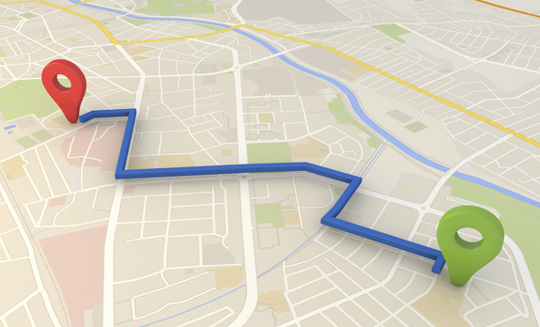
Models and Theories
Any model is an approximation of the situation.
The closer the “match,” the more useful the model.
All models are correct – in some other world.
W. Edwards Deming
All models are wrong – but some are useful.
George Box
You never understand a theory until you know where it does not work.

Slide 14
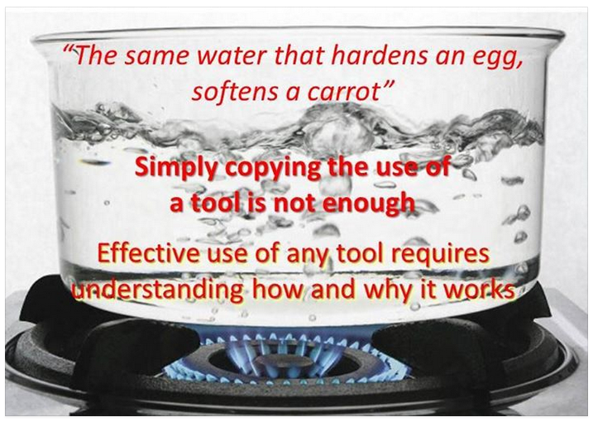
Models (and theories) must be viewed in a context

Slide 15
Day 1 Homework
Details of your homework assignment (to be completed prior to coming to class on Wednesday/Thursday) are posted at faculty.ung.edu/kmelton/busa3110.html
This assignment includes
  reading the entire syllabus
  reading a short article available online
  watching some YouTube videos (about 10 minutes total)
  bringing printed out / written material to class next time
  setting up access to MyStatLab and watch one video
  obtaining your book
We will meet in the lab on Wednesday/Thursday
(Nesbitt 5100 or Newton Oakes 109)

Slide 16
Syllabus
Text, MyStatLab, JMP, D2L, MS Office
Accessing material D2L and MyStatLab
Software Availability: JMP and MS Office
Course Format
Grading
General expectations (especially deadlines, make-ups, extra credit, academic integrity, phones)
Inclement Weather

Slide 17
Format & General Expectations
Learning is not a divided responsibility (not I teach, you learn)—learning is a joint responsibility (we learn together)
My “hot buttons”
  Timeliness
  Ethical behavior
  Professional orientation toward learning
    This includes putting phones away and engaging in class
  Recognition that “true” learning involves more than getting the right answer

Slide 18
Grading
90 and above | A
80 – 89 | B
70 – 79 | C
60 – 69 | D
Below 60 | F
MyStatLab Homework (16 points)
  Drop the lowest two and average the rest [then take percent of 16]
MyStatLab Quizzes (16 points)
  Average all [then take percent of 16]
Instructor Supplied Assignments (64 points)
  Eight assignments each graded out of 8 [add them up]
Preparation / Participation (10 points)
  Total earned/total available [then take percent of 16]
Pre-final grade = Add the points from each section
Final (0-16 points)
  Two problems each out of eight point [treated as Instructor Supplied Assignments 9 and 10]
Final Grade = Points from (HW + Quizzes + Preparation / Participation + 8 Highest Instructor Supplied Assignments)

Slide 19
Instructor Supplied Assignment Topics
(Tentative List)
Fundamentals of using JMP
Summarizing Data
Collecting “Good” Data for Statistical Inference
Inference about One Variable
Simple Linear Regression
Equations, Graphs, Model Statements, Hypotheses
Multiple Regression and Testing Theories
Model Building and Selecting the “Best” Model

Slide 20
A Word about Deadlines
(MyStatLab and D2L)
Deadlines are set to:
  Allow you time to see assignments well before the due date
  Allow you time to complete the assignments after the material is covered
  Provide you with as much time as possible prior to when I will start grading
    Therefore, I will use early morning deadlines rather than late night deadlines (giving you the option of the overnight hours to work)
    Remember, you can submit assignments before the deadline

Slide 21
Content
Data
Information
Wisdom
Knowledge
Six “Modules” (Sets of Slides)
  Preparing Data for Analysis
  Summarizing Data – Visually and Quantitatively
  Collecting “Good” Data (for Inference)
  Inference Involving One Variable
  Simple Linear Regression
  Multiple Regression and Model Building

Slide 22
Data/Information/Knowledge/Wisdom
Doing the right things
(Effectiveness)
Evaluates knowledge/understanding;
deals with values; uses judgment;
answers what is best and why
WISDOM
KNOWLEDGE/
UNDERSTANDING
Explains; provides answers to how to
and why questions
Doing things right
(Efficiency)
Describes; provides answers to who,
what, where, and when questions
INFORMATION
Symbols (raw values) that represent
properties of objects/events
DATA
Based on the work of Russell Ackoff. See “From Data to Wisdom” in Ackoff’s Best, pp. 170-174, 1999.

Slide 23
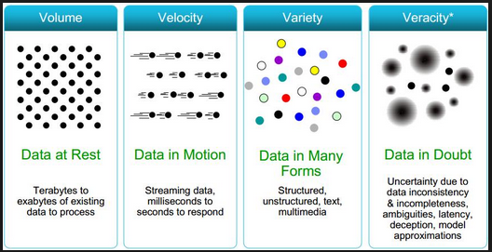
How (and Why) is the Field of Statistics Changing?
Think “Data”
Source: http://www.datasciencecentral.com/profiles/blogs/data-veracity

Slide 24
The Historical Role of Data in Statistics
Describe (Descriptive Statistics)
  Summarizes data
    Graphically
    Through formulas and tables
Infer (Inferential Statistics)
  Use data from a small number of observations to draw conclusions about the larger group
Improve (Process Studies)
  Use data from past experience to help predict expected outcomes at a different time or place or to direct action to influence future outcomes

Slide 25
The Evolving Role of Data in Statistics
Descriptive/Informative
  Includes current descriptive and inferential statistics
  Looks at past and current performance to “describe”
Predictive/Explanatory
  Looks at past and current performance with a goal of predicting future performance
  (i.e., to be able to “explain”)
  Addresses “what if” questions
Prescriptive/Understanding of Interactions & Implications
  Uses quantitative models to assess how to operate in order to achieve some objective within constraints (and may include deterministic and probabilistic aspects)

Slide 26
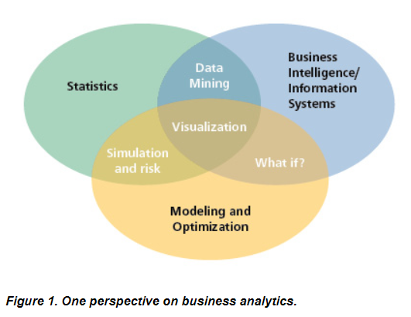
The Changing Face of Statistics
Business Analytics
Big Data
Descriptive,
Predictive,
Prescriptive
http://www.decisionsciences.org/decisionline/
Vol43/43_2/dsi-dl43_2_feature.asp

Slide 27

http://wishafriend-quotes.s3.amazonaws.com/future/4375-future.jpg

Slide 28
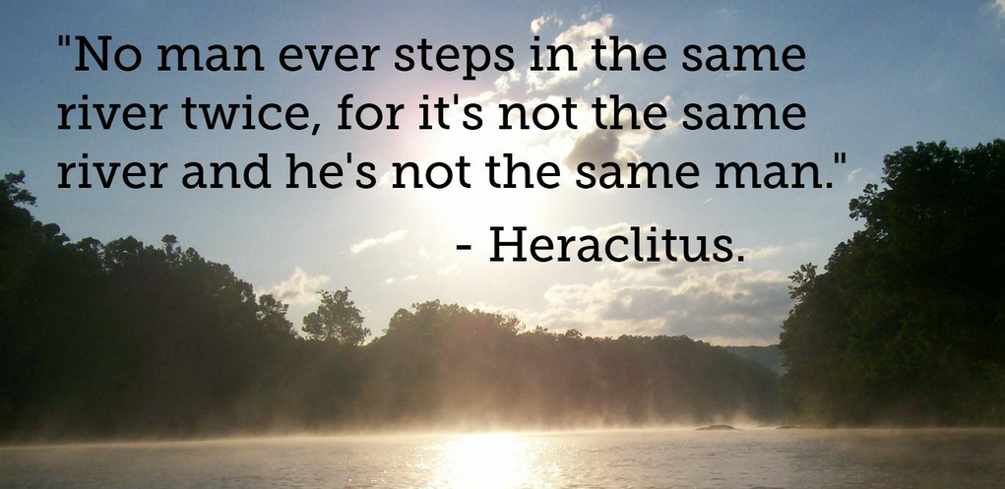
http://cdn.slowrobot.com/12122012115335.jpg

Slide 29





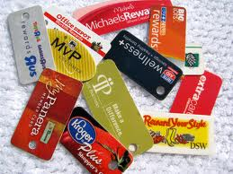




Analytics

Slide 30
What do we mean by “good data”?
Considerations when you are collecting data
Considerations when you are evaluating reports that claim to be based on data

Slide 31
Day 2 Homework
More details at faculty.ung.edu/kmelton/busa3110.html
This assignment includes:
  Reading two chapters in your book
  Tying the text material to the readings and videos from Day 1

