Slide 1
Fall 2016 BUSA 3110 - Statistics for Business Module 1: Preparing Data for Analysis
Kim I. Melton, Ph.D.
All students have been moved the D2L Statistics for Business Section 1 Fall 2016.

Slide 2
Why Start with the first & LAST Chapters in the Book? (Chapters 1 and 24)
This is a second course in statistics.
Chapter 1 refreshes your memory on some of the basics related to collections and analysis of data
Chapter 24 lets you reflect on the tools/techniques from the first course…and sets the stage for applying the tools in a real-world environment.
CONTEXT

Slide 3


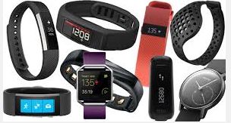
Characteristics of “Good” Data
Accuracy of measurement
Precision of measurement
Uses an appropriate type data (and level of measurement)
Qualitative: Nominal, Ordinal
Quantitative: Interval and Ratio – often these are grouped together [JMP calls these “continuous”]
Aligns with the characteristic of interest
Different numbers reflect differences in the items measured (rather than an inability to measure consistently)
Measurement is a yardstick for “how we are doing” rather than the “mission”
Parking Space Reserved for Drive-Thru

Slide 4
Roadmap
Data - Day 1: The Basics (Chapter 1) in Context (Chapter 24)
Variables and Data
Operational Definitions
Data Types (Character or Numeric)
Modeling Type
Qualitative: Nominal, Ordinal,
Quantitative: Interval, Ratio [JMP groups these and calls them Continuous]
Putting Data in Context (Chapter 24)
Data - Day 2: Preparing Data for Analysis (JMP Session 1)
Data Tables vs. Spreadsheets
Data Cleansing
Obtaining and saving output
Creating summary tables

Slide 5
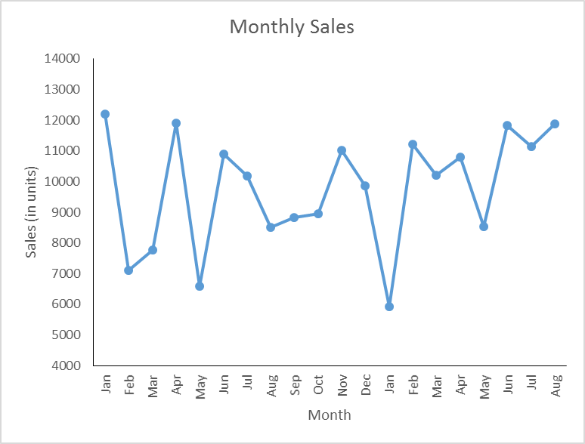
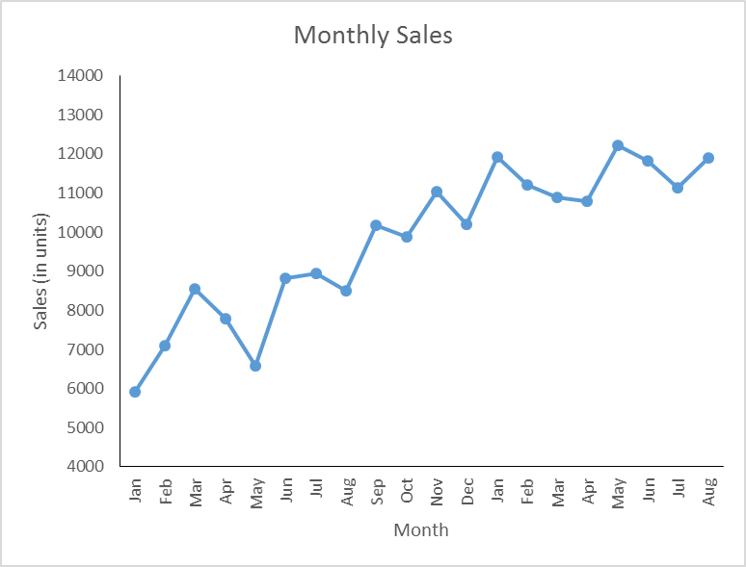
WHY? Describe, Explain, Understand, Predict, Prescribe
What were our sales for the month? (describing)
How does this compare to the same month last year? (still describing)
What’s changed that might account for the differences? (moves toward explaining)
Why have sales changed? (starts to move from explaining to understanding)
What will sales be in the future? (predicting and/or prescribing)

Slide 6
Data for Decision Making
Major issues
Purpose (descriptive, predictive, prescriptive)
Measurement Level (quantitative/qualitative, nominal, ordinal, interval, ratio)
Variable choice and definition
Sources of variation (population, across time, process)
Cross sectional, time series
Population, process
Methods of accessing (primary, secondary)
Choice of observations (random, convenience, rational)
External influences (ethical and practical)

Slide 7
Putting Data in Context (5 W’s and H)
Who does the data describe (doesn’t have to be people)
What characteristics are recorded (variables of interest)
Why are we collecting data (purpose, guiding questions,…)
How were the data collected (theory-wise and physically)
Sampling, convenience, primary or secondary data, training for data collection
Operational definitions will describe what is “measured”, how the measurements are taken (getting to the level of measurement level/modeling type and method of measurement), and provide a way that two people looking at the same item would come to the same conclusion about the characteristic.
When were the data collected (date/time, across time, …)
Where were the data collected (geographic, point in process, source…)

Slide 8
Terms
The item that will be observed/measured (who): respondent, record, participant, experimental unit, subject, record (what is represented in one row of a data table)
Variable(s) (what-macro): the characteristics of interest that could vary from one item to another
Data (what-micro): the observed values for the variable
How: the method for selecting items to observe: sampling, census, convenience

Slide 9
Variable Choice and Measurement Level (Modeling Type)
Measurement Level/Modeling Type
Identify the Level/Type
Nominal (Qualitative, Categorical)
Ordinal (Qualitative, Categorical, Logical to Order the Categories)
Interval (Quantitative, Differences have consistent meaning)
Ratio (Quantitative, Differences and Ratios have meaning) JMP combines Interval and Ratio and calls these “Continuous”
Major
Grade in a course
Job title
Year in school (Freshman,…, Senior)
Price of a gallon of regular gas
Salary
Rank of your favorite college team
Size of a house
Gender
Level of agreement (1, 2, …, 9, 10 where higher numbers relate to stronger agreement)

Slide 10
Other Issues in Data Collection
External influences (practical and ethical)
Practical (time, money, access)
Ethical
policies that can interfere with collecting good data:
evaluation systems that look at components separately
reward systems
quotas and arbitrary goals
fiscal year budgets
Other issues to cover in Chapter 8
Methods of accessing (primary, secondary; survey, experiment, observational)
Choice of observations (random, convenience, rational)

Slide 11
24.5 Successful Data Mining
The first step is to have a well-defined business problem, which can help you avoid going down a lot of blind paths.
Typically, 65% to 90% of the time is spent in data preparation – investigating missing values, correcting wrong entries, reconciling data definitions, or creating new variables from old ones.

Slide 12
24.8 The Data Mining Process
(and data analysis in practice)
The process must start with the Business Understanding phase.
Data Understanding is central to the entire data mining project – it is crucial to understand the data warehouse, what it contains, and what limitations are present.
Once variables are selected and the response variable has been agreed upon, the Data Preparation phase begins.
Following preparation is the Data Modeling phase. The more knowledge of the data and the variables that goes into the model, the higher the chances of success for the entire project.
Finally, if the model seems to give business insight, it’s time for the Deployment phase – just keep in mind that the business environment changes rapidly, so models can become stale quickly.

Slide 13
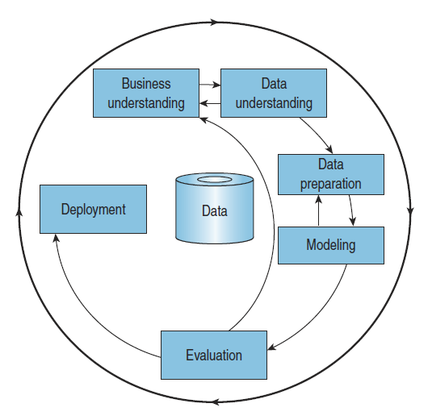
24.8 The Data Mining Process
(and also applies to most any data analysis in practice)

Slide 14
24.4 Data Mining Myths
Myth 1: Find answers to unasked questions.
Myth 2: Automatically monitor a database for interesting patterns.
Myth 3: Eliminate the need to understand the business.
Myth 4: Eliminate the need to collect good data.
Myth 5: Eliminate the need to good data analysis skill.

Slide 15
Data – Day 2
JMP Session [Tutorial in D2L]
Accessing JMP and a Data Table (with data)
Setting Data and Modeling Types
Value Ordering Ordinal Scale data
Recoding data
Obtaining output
Customizing output
Saving scripts and data tables
Creating tables
Including JMP output in a Word document

Slide 16
Data – Day 3
No face-to-face class Monday or Tuesday. See D2L for complete assignments with deadlines for completion prior to class on Sept. 7 or 8 [in the lab].
Review the material from the first JMP lab
Watch MyStatLab Video 2 (8/28 – 9/4); the following are also available: MyStatLab HW 2 (8/29 – 9/10) and Video 3 (9/4 – 9/11).
Complete the Roll Verification Quiz on D2L (9/1)
Load JMP on your computer and complete the JMP Installation (P&P) assignment in D2L Dropbox (due by 11:30pm on 9/6)
Read the Gallup article
Start the first Instructor Provided Assignment (D2L Dropbox 8/31 – 9/11 1:00pm)

